Slide 1

Hospital Management System
A console-based C++ application that automates patient record management using fundamental data structures — Arrays and Queues.
C++
DATA STRUCTURES PROJECT
2025–2026

Slide 2

The Problem We're Solving
Traditional paper-based hospital systems are slow, error-prone, and unscalable. As patient volume grows, maintaining accurate, accessible records becomes a critical challenge.
Manual Paperwork
No Queue Management
Prone to errors and difficult to update in real time.
First-come-first-served order is hard to enforce manually.
Inefficient Search
Finding a specific patient record wastes valuable time.

Slide 3
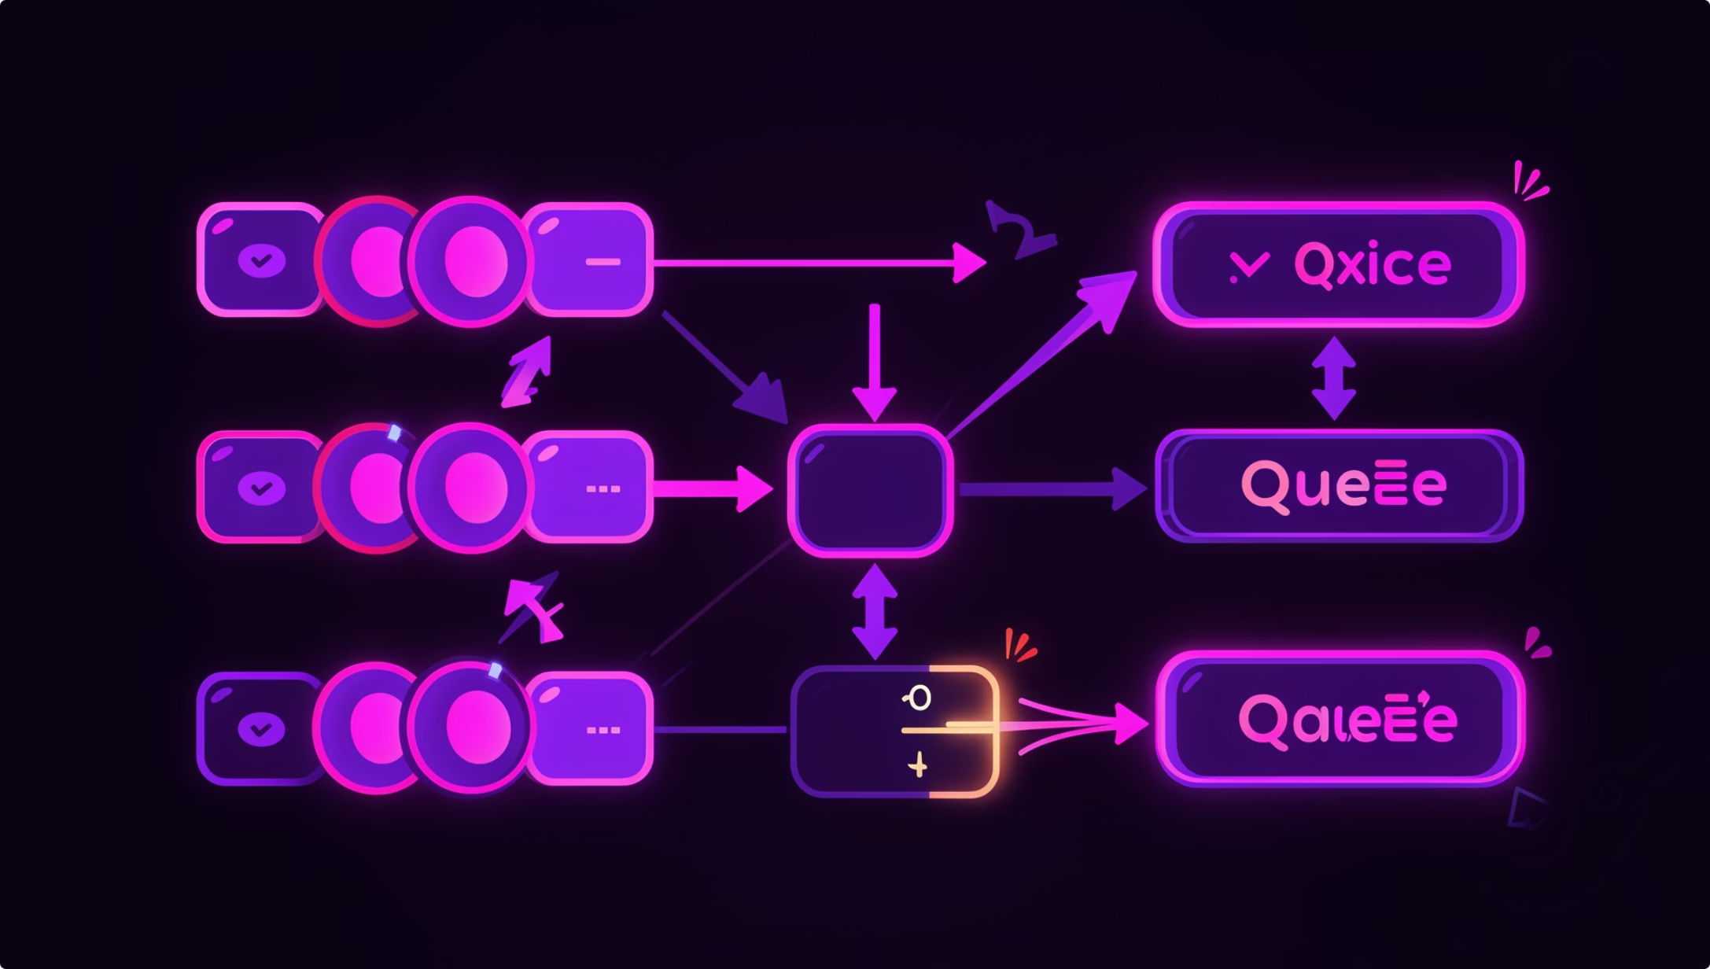
Core Data Structures
Array — patients[100]
A fixed-size array of Patient structures (capacity: 100). Enables constant-time indexed access for iteration, search, and deletion.
Queue — waitingQueue
A C++ STL queue<int> storing patient IDs in FIFO order, mimicking real hospital queuing behavior.

Slide 4








Four Core Operations
Add Patient
View Patients
Registers a new patient with ID, name, and age. Enqueues ID into waiting queue.
Iterates and displays all registered patient records with full details.
Search Patient
Delete Patient
Linear search by unique Patient ID. Returns name and age if found.
Removes a record by ID and shifts remaining elements left to fill the gap.

Slide 5

System Algorithm
Initialize
Display Menu
Execute Operation
Repeat / Exit
The program runs in a do-while loop, displaying the menu after every operation until the user selects Exit. A switch-case routes each valid choice to its dedicated function.

Slide 6
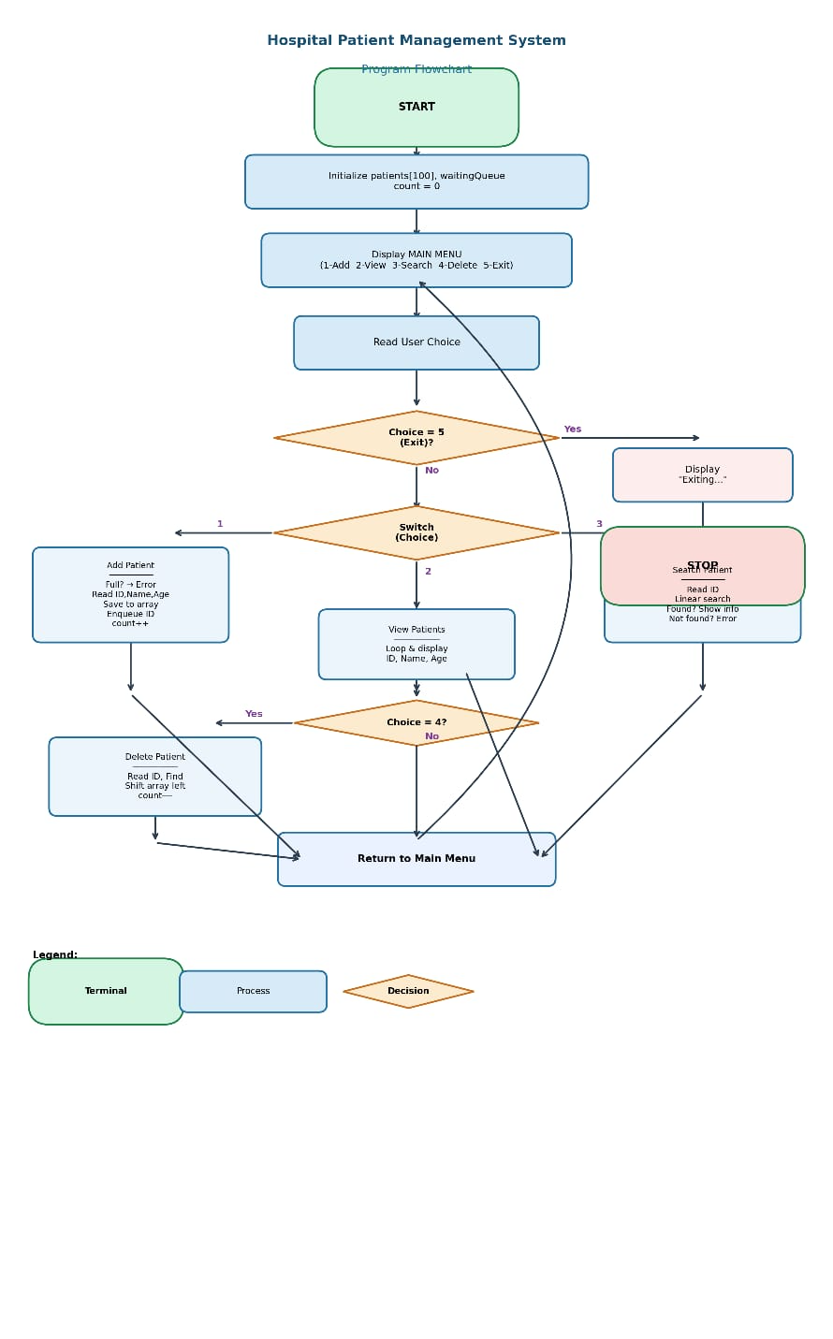
Flowchart
The program starts and initializes patient records and count.
Main menu is displayed with options: Add, View, Search, Delete, Exit.
User enters a choice.
If Exit (5) →

Slide 7
Module Complexity & Design
Design Highlights
Function
Structure
Complexity
Modular design — four dedicated functions keep code maintainable
Boundary checks — count ≥ 100 prevents array overflow
Edge case handling — empty list, not found, full array
Deletion strategy — left-shift maintains a compact array
addPatient()
Array + Queue
O(1)
viewPatients()
Array
O(n)
searchPatient()
Array
O(n)
deletePatient()
Array
O(n)

Slide 8
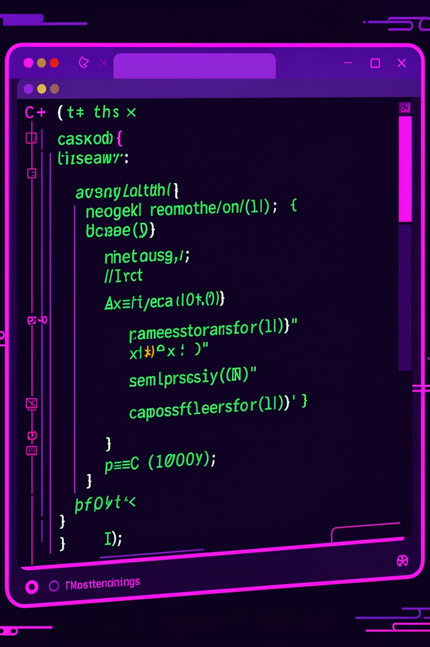
Source Code Structure
Libraries
<iostream>, <queue>, <string> — all standard C++11
Patient Struct
Three fields: id (int), name (string), age (int)
Global Variables
patients[100], count, and queue<int> waitingQueue
Main Loop
do-while with switch-case driving the menu interface

Slide 9
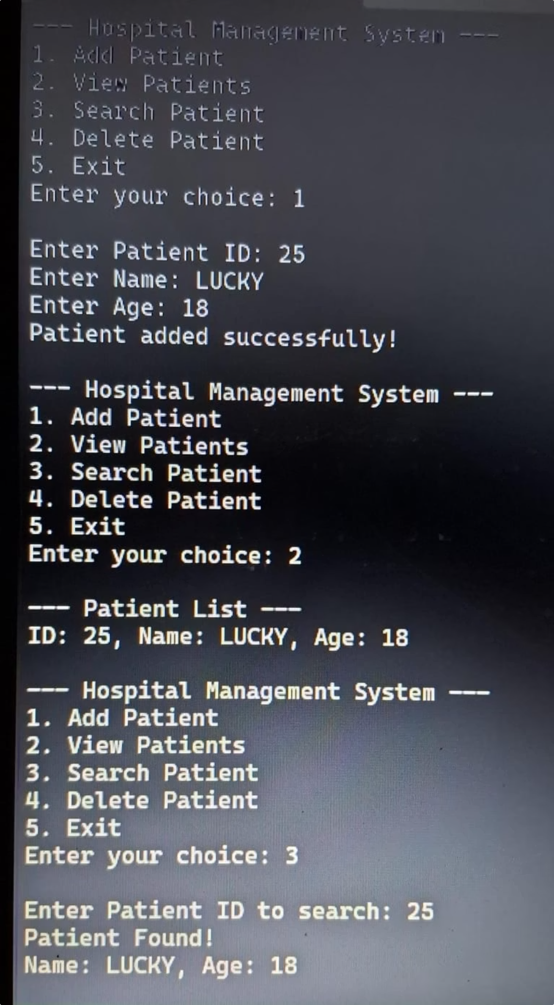

Results & Performance
All Operations Verified
Add, search, and delete executed without errors with constant-time response.
Queue Order Preserved
FIFO insertion order maintained correctly for all added patients.
Edge Cases Handled
Empty list, full array, and missing patient IDs handled gracefully.

Slide 10

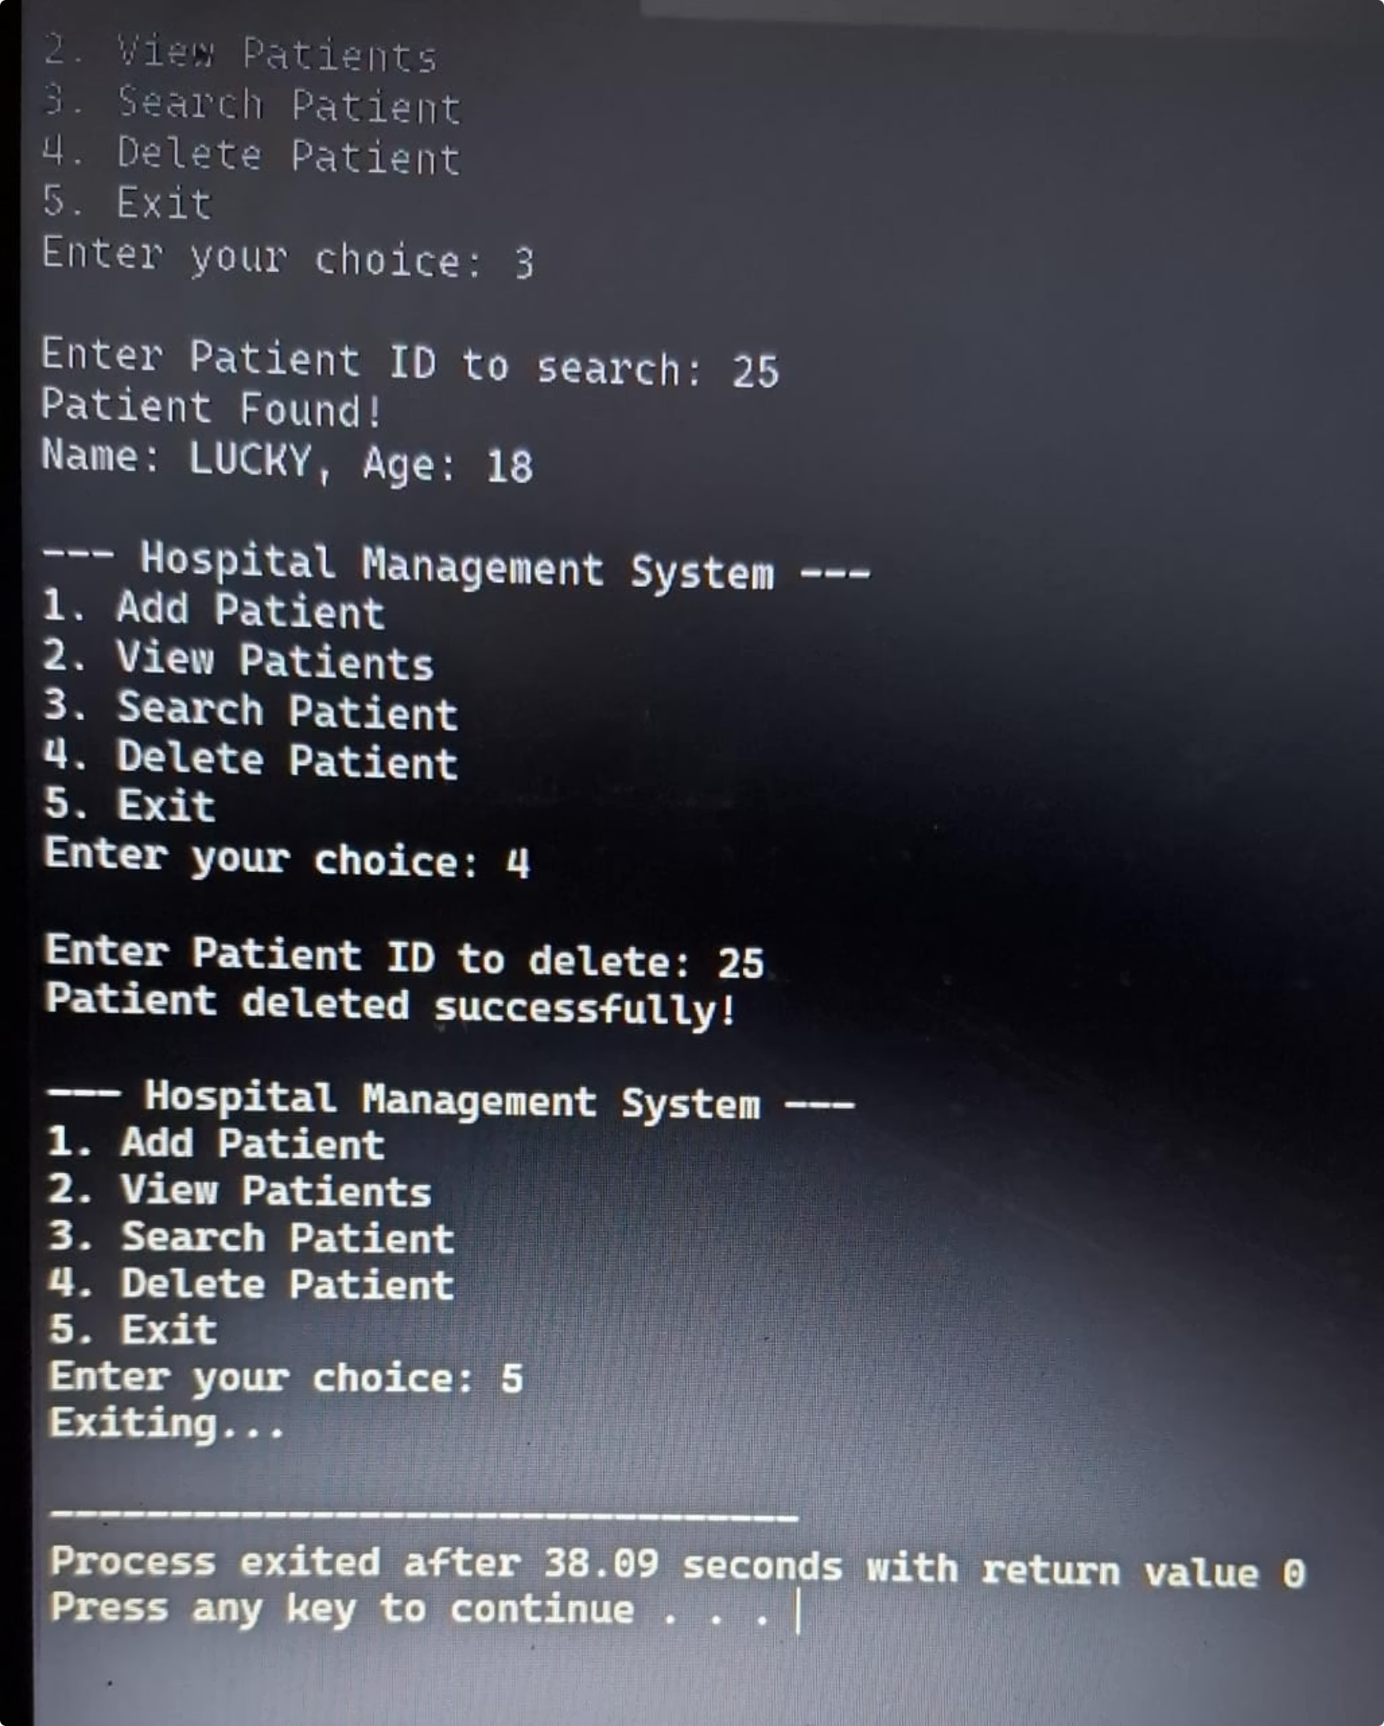
Conclusion
The system successfully demonstrates that arrays and queues are powerful tools for solving real-world healthcare management problems.
Array Strength
Queue Strength
Direct indexed access and compact, contiguous storage.
Naturally models first-come-first-served waiting scenarios.
Foundation Built
A strong base ready to extend into a full hospital information system.

Slide 11




Future Enhancements
File I/O & Database
Priority Queue
Persist records between runs; replace in-memory array with SQLite for scalability.
Handle emergency patients ahead of regular queue using priority queuing.
Appointments & Doctors
GUI & Multi-User
Add date/time fields and link patients to specific doctors or departments.
Build a Qt or web interface with authentication and role-based access control.

